Slide 1
Midterm #2

Slide 3
Dataset
You can download the dataset from here:
https://mega.nz/file/bU1HhCSC#sO7RSM2VkiVv9Rb-vTcWestE3oNBmHiFk0HxnY7FHWc
It contains files from… 3 dangerous Malware families!!!
But don’t worry, the malicious files have been already disassembled and are now in innocuous .txt format
Furthermore, to save your time, they have already been split in directories (one per each family)
The files contain all the opcodes (instructions) that form the binary file

Slide 4
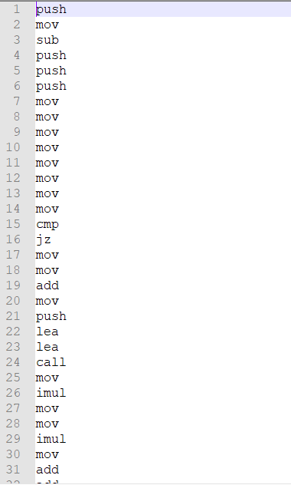
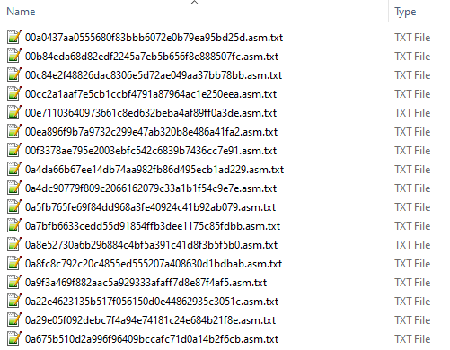

Slide 5
Preprocessing
Order the opcodes based on number of occurrence PER FAMILY and associate to each of them a specific symbol (ex: A, B, 1, 9, X, C, ....)
Note that the least common opcodes should all be converted to the same character/digit
How many unique symbols to use becomes a tuning parameter
Per each file in the training set, you will convert the opcodes accordingly to the previous preprocessing steps

Slide 6
Algorithms
You can follow one of these two methods to feed the ML algorithm:
[Method 1] The opcodes read from the files will be directly used to train the ML algorithms
[Method 2] Instead of converting the opcodes directly to symbols, you will convert the n-grams of the opcodes
The main algorithm to use will be HMM
You will need to train an HMM per each malware family based on the chosen Method
NOTE: You can apply Ensemble Learning to increase your detection rate

Slide 7
Experiments
The dataset contains three families:
Winwebsec, Zbot, and ZeroAccess
You will need to return the classification accuracy of these SIX tests:
Test 1 and 2: Winwebsec vs Zbot
Test 3 and 4: Winwebsec vs ZeroAccess
Test 5 and 6: Zbot vs ZeroAccess

Slide 8
Report
You will need to submit a report split in these sections:
Pre-processing: Explain all the steps and eventual tools used to preprocess the dataset
Tuning: Describe all the tuning parameters used (and why) and collect them in a well-defined table
Experiments: Describe the output of your experiments in term of accuracy
Conclusions: Conclude the report reviewing all the steps, mentioning the best outcome, and proposing a Future Work paragraph where you hypothesize new possible experiments

